Slide 1


Health Care, Health Scare ?

Slide 2
Overview
About “Scare tactics or threat appeals”
A history of fear-based messaging in public health
Anti-tobacco and anti-AIDS public health campaigns
Effectiveness of fear appeal
Theories and meta-analyses
Evidence-based intervention
New York City’s Experience with Fear-Based Public Health Campaign

Slide 3

Scare Tactics or Threat Appeals
“Fear appeals are persuasive messages designed to scare people by describing the terrible things that will happen to them if they do not do what the message recommends.” (Witte K., 1992)
Often presented as a warning. The tactic involves using images or messages to elicit negative emotions such as anxiety in the expectation that the audience will be motivated to adopt the healthier behaviors
Commonly used as a strategy for changing behaviors within a population in relation to public health initiatives, such as antismoking, anti-drunk driving campaigns as well as in hypertension awareness campaigns.

Slide 4

History of fear-based messaging in Public Health
Before World War II, Public health scare campaigns and panic mongering had, on occasion, been the subjects of popular or medical challenge.
In the Cold War era (1946-1947), fear came under more systematic attack due to the increasing weariness with the “politicization of terror”.
From 1950s through 1970s, an anti-fear canon guided thinking. A landmark empirical study suggested that using fear would backfire (Irving J. and Seymour F. 1953) . Yet faced with limited effectiveness of informational approaches, anti-tobacco campaigns featured fear in the 1960s, and early global anti-AIDS campaigns also employed fear.

Slide 5

History of fear-based messaging in Public Health
Into the 1980s, ethicists began to question whether fear could cross the boundary from education to manipulation, and worried about the stigma employed by fear-based efforts.
More recently, fear-based efforts were met with a mixture of outrage and support. Changing politics of fear-based campaigns took place against the backdrop of a steadily growing empirical literature making the case that fear delivered correctly , worked. (A groundbreaking 2015 meta-analysis)
This Is Your Brain on Drugs, 1987
The Partnership used a simple advertisement showing an egg in a frying pan, similar to this photo, suggesting that the effect of drugs on a brain was like a hot pan on an egg.

Slide 6

Public health campaigns against Tobacco (post-World War II)
Primarily language of odds and probability – “The two-pack-a-day smoker multiplies his chances of lung cancer 52 times.”
Shifted to scare tactics to compete with the advertising (promoting smoking cigarettes as a lifestyle choice) from tobacco industry.
Evoked fear and guilt of harming others and oneself, and tone became sharper in the late 1970s.
Hit harder and harder, and provoked little protest outside the tobacco industry.
Graphic tobacco warning on cigarette packages (FDA)
Samples of graphic warning label.
(Peter Morenus/UConn Photo)

Slide 7
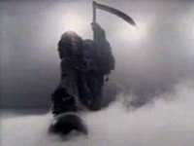
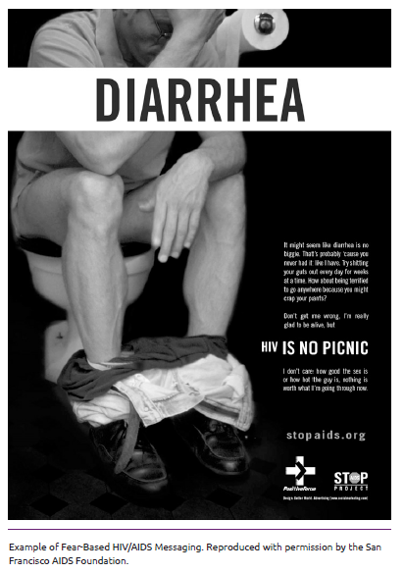
Public health campaigns against AIDS (post-World War II)
Grim Reaper commercial, 1987,
Australia
Heavy use of emotional appeals in early AIDS-related campaigns gave rise to powerful rights-based social movement, denouncing these messages as stigmatizing. – Halted use of fear.
However, after the advent of highly active antiretroviral therapy in the 1990s, infection rates ticked up, particularly in young minority men. With growing concerns about complacency and the risks of HIV transmission, San Francisco, Baltimore and New York adopted hard-hitting campaigns.
Agreement: with AIDS, fear overcame opposition only when it was framed as fair warning with the potential to correct misperceptions.

Slide 8
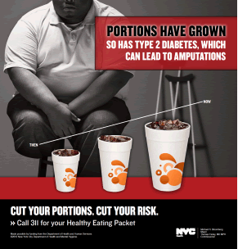
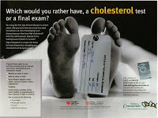

Question
Does fear appeal work ?

Slide 9
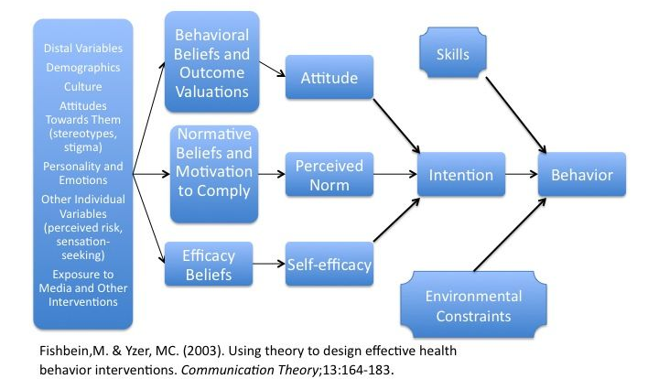


An Integrative Model of Behavioral Prediction

Slide 10
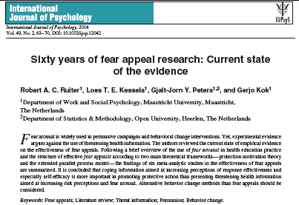
More than sixty years of research
Seven Theories explaining fear appeals in behavior change:
Linear model of fear appeals
Curvilinear model of fear appeals
Health belief model
The parallel process model
The extended parallel process model
The stage model
The elaboration likelihood model
Landmark Meta-analyses
Threatening communication: a critical re-analysis and a revised meta-analytic test of fear appeal theory (Peters et al.,2012)
Appealing to Fear: A Meta-Analysis of Fear Appeal Effectiveness and Theories (Tannembaum et al., 2015)

Slide 11
Threatening communication: a critical re-analysis and a revised meta-analytic test of fear appeal theory
(Peters et al.,2013)
Background of the study
Despite the past six decades of research into threat communication effectiveness, consensus remains elusive.
Two theories prevailed: the extended parallel process model (Witte, 1992) and the stage model of processing of fear-arousing communications (de Hoog et al., 2007). Both postulate that behavior change is the function of a perceived threat, but only when there is sufficient perceived efficacy.
However, meta-analyses consistently found main effects of threat and efficacy, and there was no evidence for the predicted interaction effect, implying that higher threat simply results in more behavior change(de Hoog et al., 2007; Witte, 1994).
Notes:
Efficacy is one’s ability to negate the harm, a function of the effectiveness of a
potential response in negating the harm (response efficacy) and one’s capability to
enact that response (self-efficacy)

Slide 12
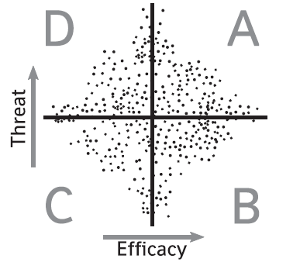
Threatening communication: a critical re-analysis and a revised meta-analytic test of fear appeal theory
(Peters et al.,2013)
Two problems with research that may explain this divergence between theory and evidence
Fear appeal theory and SOB (significant outcome bias manifested in publication bias)
The intention-behavior gap: intention typically predicts around one-third of behavior, and medium-to-large changes in intention typically lead to only small-to-medium changes in behavior, etc. Therefore, when a study shows an effect of threatening communication on intention, but fails to measure behavior, it is possible that the fear appeal is not associated to, or even decreases, the desirable behavior.
Avoidant
Responsive
Indifferent
Proactive
Most published experiments
Notes:
Populations in quadrant A are responsive:
their members are high in both efficacy and perceived threat. The EPPM predicts that these participants will be easy to convince to conduct the desired behavior (if perceived threat is not already at the highest level).
Participants in quadrant B are proactive:
they have high efficacy but low threat. When presented with threatening information,their high efficacy will prevent defensive reactions and their perceived threat will increase, bringing them to quadrant A and causing them to perform the desired behaviour.
Participants in quadrant C are indifferent:
low in both threat and efficacy.Presenting them with threatening information will cause them to react defensively,dismissing the threat.
Finally, participants in quadrant D are avoidant:
they are already high in threat but low in efficacy. Their perceived threat cannot be increased further, and threatening communications again trigger defensive reactions.
When an experiment presents a threatening communication to a behaviour population combination in the upper parts of quadrants A or D, threat is already high, so the manipulation of threat will fail, and the SOB causes these studies to be unlikely to be published. When doing a threat communication experiment using a behaviour-population combination in quadrant C, participants will exhibit defensive
reactions (see e.g., Cho & Salmon, 2006), no desirable behaviour change is achieved,and the study is not published (SOB). Thus, current fear appeal theories, incombination with the SOB, predict that most published threat communication experiments are those conducted in populations and with behaviours in quadrant B,where the low baseline threat leaves room for a successful threat manipulation, and
the high baseline efficacy inhibits defensive reactions, allowing the threat manipulation to change behaviour.

Slide 13
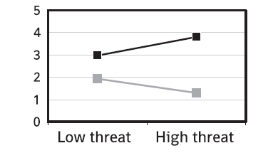
Threatening communication: a critical re-analysis and a revised meta-analytic test of fear appeal theory
(Peters et al.,2013)
Hypotheses regarding the nature of interaction between threat and efficacy were confirmed
There was no effect of threat when efficacy was low(d=-0.31, p=0.061), but there was an effect when efficacy was high (d=0.31,P=0.036);
There was no effect of efficacy when threat was low (d=0.07,p=0.689), but there was an effect when threat was high (d=0.71, p<0.0001).
Interestingly, the effect of threat under low efficacy is borderline significant and negative, suggesting that high threat may decrease behavior when efficacy is low.
High efficacy
Low efficacy
Illustration of the interaction effect between threat and efficacy on behavior, based on weighed ranked outcomes.

Slide 14
Appealing to Fear: A Meta-Analysis of Fear Appeal Effectiveness and Theories
(Tannembaum et al., 2015)
Broader scope integrating message, behavior, and audience into framework
The largest and most-comprehensive meta-analysis to date
Provides perhaps the best, if not controversial, summary of appeal to fear research
Fear appeals are effective at positively influencing attitude, intentions, and behaviors.
There are very few circumstances under which they are not effective.
There are no identified circumstances under which they backfire and lead to undesirable outcomes.

Slide 15
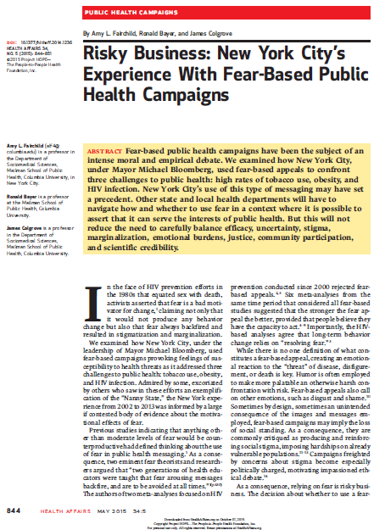
New York City’s Experience with Fear-Based Public Health Campaign
Highlights
Fear was a socially acceptable response to smoking. This would not hold true in the case of either obesity or HIV.
In the case of AIDS, community-based organizations had already successfully challenged the use of fear-based appeals.
As of 2015 the hard-hitting approach seems to have been shelved for HIV.
Emotionally evocative, graphic, even disturbing images and messages were neither as restrictive as bans nor as burdensome as high taxes.
Suggestion: Other state and local health departments will have to navigate how and whether to use fear in a context where it is possible to assert that it can serve the interests of public health. But this will not reduce the need to carefully balance efficacy, uncertainty, stigma, marginalization, emotional burdens, justice, community participation, and scientific credibility.

Slide 16
Online Sources
Appealing to fear: A meta-analysis of fear appeal effectiveness and theories (2015) https://www.ncbi.nlm.nih.gov/pubmed/26501228
Are Scare Tactics Off the Table for Public Health Campaigns Targeting HIV? (2015) https://www.mailman.columbia.edu/public-health-now/news/are-scare-tactics-table-public-health-campaigns-targeting-hiv
Appeal to fear in health care: appropriate or inappropriate? (2017) https://chiromt.biomedcentral.com/articles/10.1186/s12998-017-0157-8
Questions about scare tactics in health advocacy/awareness campaigns (2012) https://www.healthnewsreview.org/2012/02/questions-about-scare-tactics-in-health-advocacyawareness-campaigns/
Using Theory to Design Effective Health Behavior Interventions (2003) https://www.sibson.com/media/1536/using-theory-to-design-effective-health-behavior-interventions.pdf

Slide 17
Online Sources
Risky Business: New York City’s Experience With Fear-Based Public Health Campaigns (2014) https://www.healthaffairs.org/doi/10.1377/hlthaff.2014.1236
Sixty years of fear appeal research: current state of the evidence (2014) https://www.ncbi.nlm.nih.gov/pubmed/24811876
The Two Faces of Fear: A History of Hard-Hitting Public Health Campaigns Against Tobacco and AIDS (2018)
https://www.ncbi.nlm.nih.gov/pubmed/30088996
Researchers document history of fear in public health campaigns(2018) https://vitalrecord.tamhsc.edu/researchers-document-history-of-fear-in-public-health-campaigns/
Threatening communication: a critical re-analysis and a revised meta-analytic test of fear appeal theory (2012)
https://www.ncbi.nlm.nih.gov/pmc/articles/PMC3678850/
Health care? More like health scare! (2017)
https://lowninstitute.org/news/health-care-like-health-scare/

Slide 18
Thank You

